Slide 1


Building DApps with Ethereum
The Ethereum Ecosystem, Blockchain Nodes, Web3.js, Remix, Truffle
Sevgin Mustafov
Blockchain Developer & Course Developer
Academy School of Blockchain
http://kingsland.academy

Slide 2



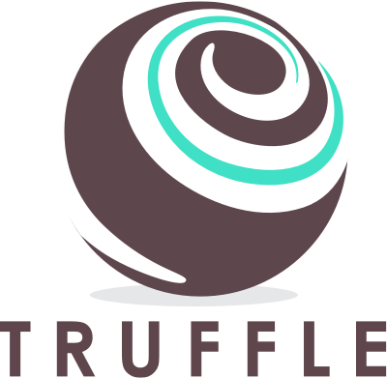
Table of Contents
The “Ethereum” Ecosystem
Decentralized Blockchain Apps (DApps)
What is TestRPC?
Blockchain Nodes
MetaMask
JavaScript Library – Web3.js
Truffle
Front-End Frameworks

Slide 3
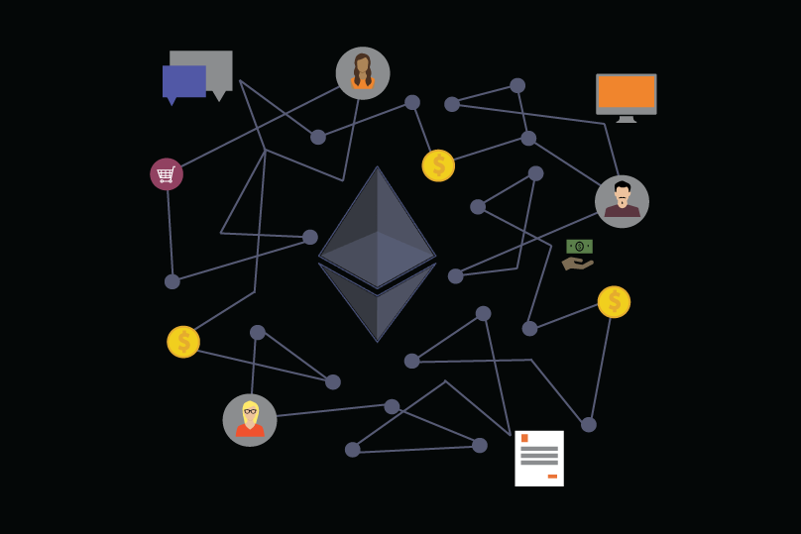
The Ethereum Ecosystem
Ethereum Clients, Nodes and Tools

Slide 4
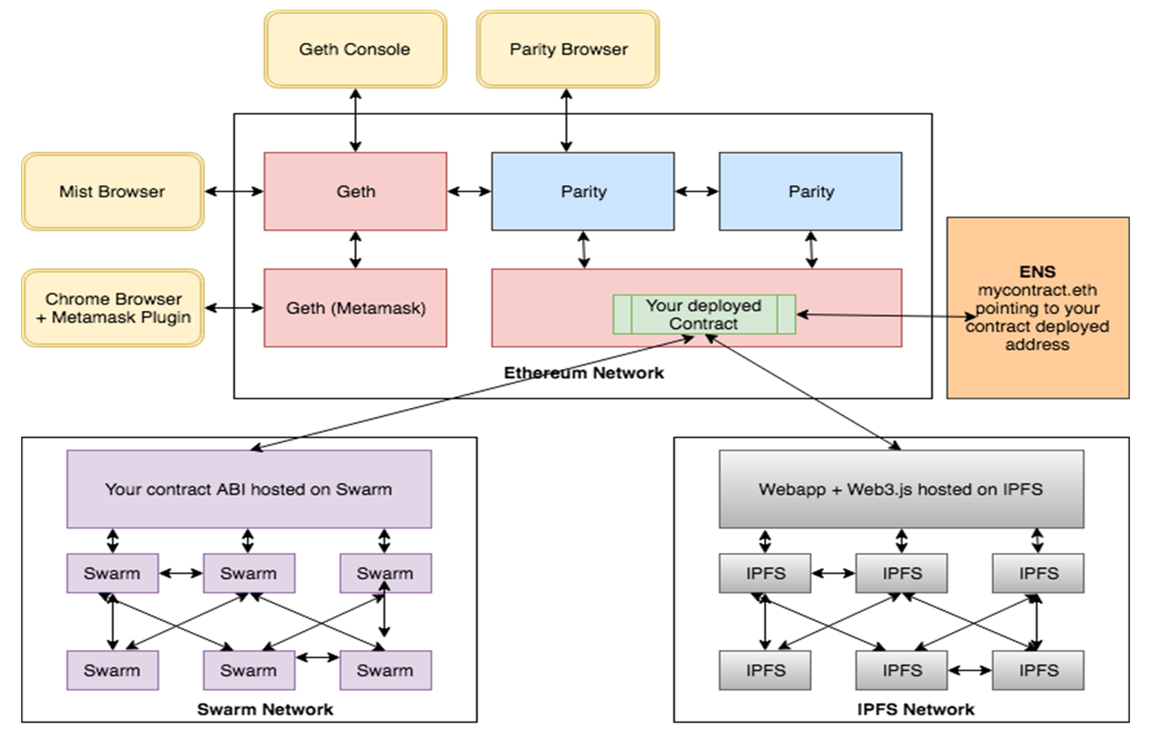
The Ethereum Ecosystem

Slide 5
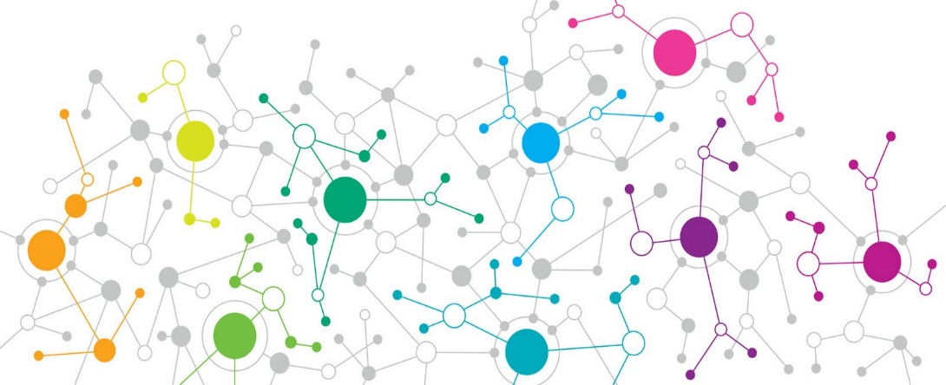
Decentralized Blockchain Apps (DApps)
DApps
DApps hold backend code and data on the blockchain
The front-end is still a traditional app
Client App (front-end)
HTTP
Traditional Backend Server-side code + data
RPC
RPC
Smart Contract Backend Code + data on the blockchain

Slide 6
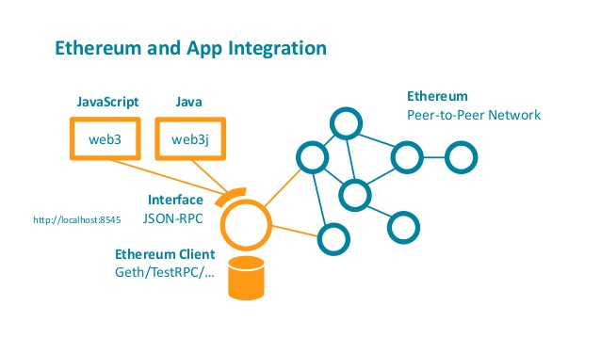
What is Ganache-CLI / TestRPC?
Node.js based Ethereum server
For development and testing
Uses ethereumjs to simulate full client behavior
Make developing Ethereum applications much faster
Includes all popular RPC functions and features
npm install -g ethereumjs-testrpc
npm install -g ganache-cli

Slide 7
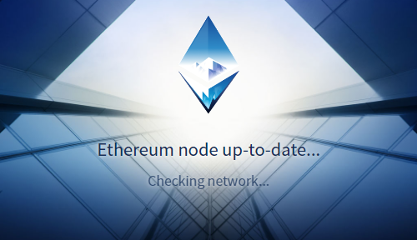

Blockchain Nodes – Go-Ethereum (Geth)
The official Ethereum node software, written in Go
Connects to other clients / nodes
Downloads a copy of the entire blockchain (takes time)
Keep it’s copy of the blockchain up to date
Mine blocks
Send transactions
Validate the transactions
Execute the transactions

Slide 8
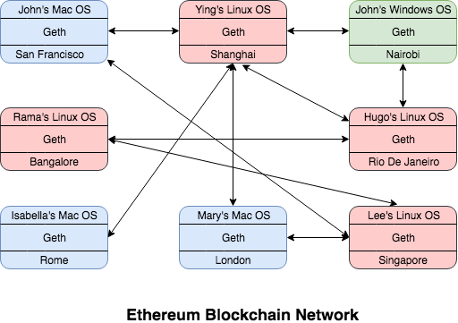
Blockchain Nodes – Go-Ethereum (Geth) (2)
geth console
Command line tool
Starts a local node / connect to other nodes
Create and manage accounts
Query the blockchain
Sign and submit transactions
https://geth.ethereum.org/downloads

Slide 9
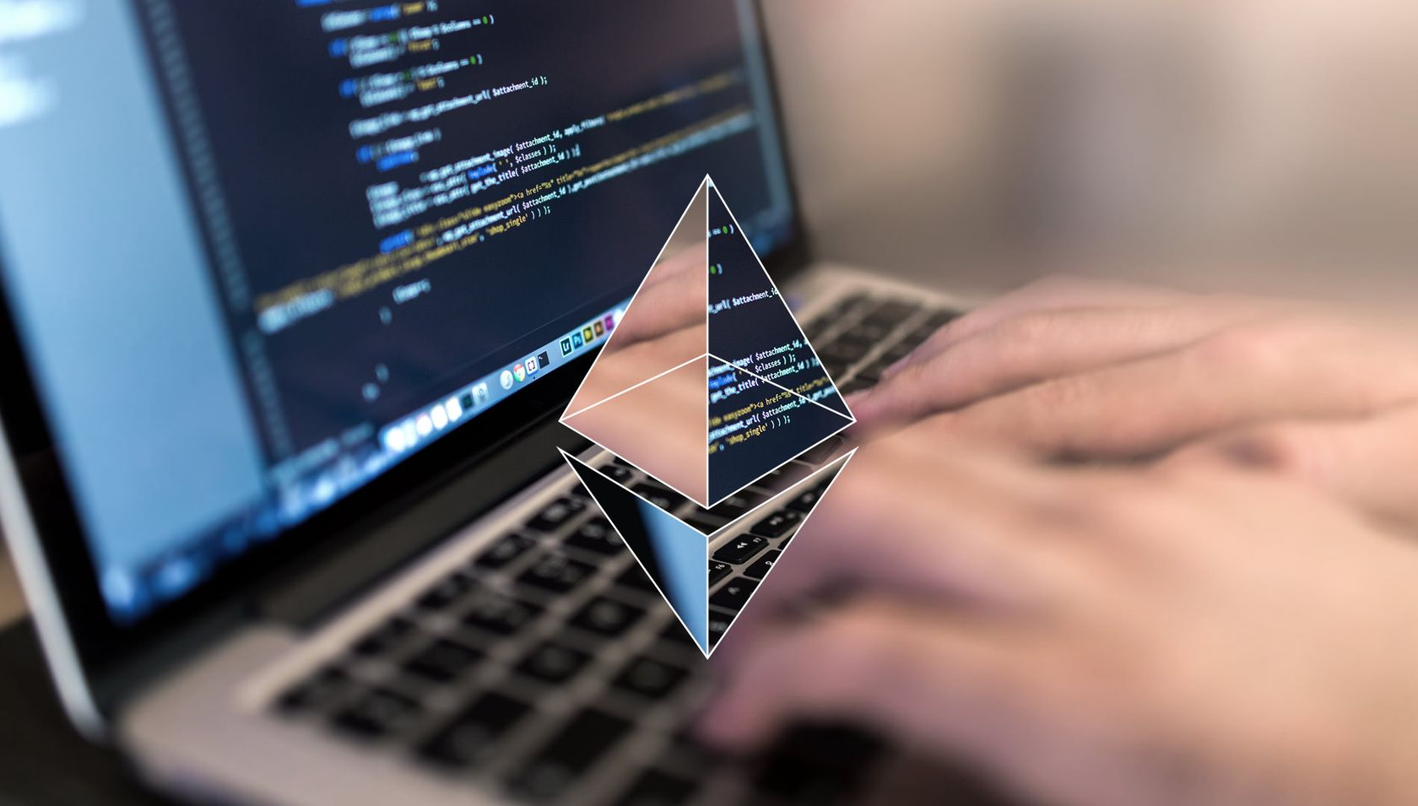
Live Demo
Playing with Geth

Slide 10
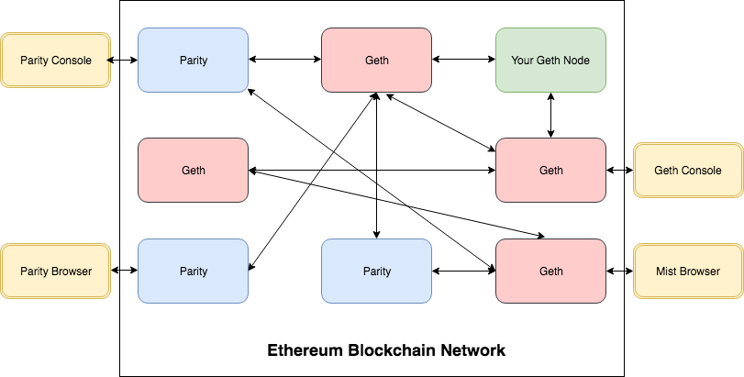
Blockchain Nodes – Parity
Implementation of the Ethereum protocol, written in Rust
It is an unofficial Ethereum client, used to run a node
Maintained by a company called Parity Inc. (by Gavin Wood)
Anyone can implement the client software and join the Ethereum network
https://www.parity.io

Slide 11

Live Demo
Playing with Parity

Slide 12
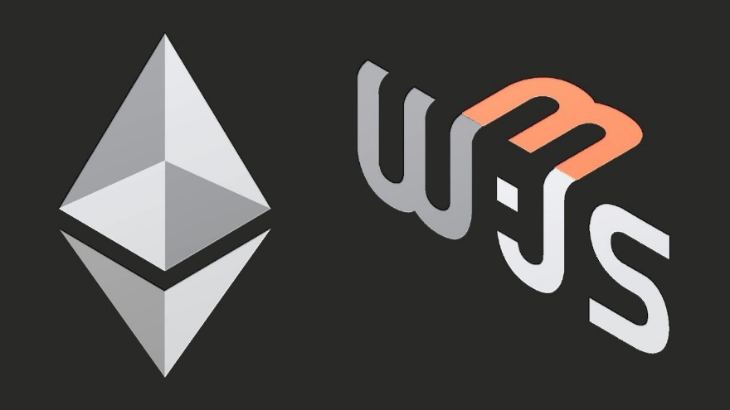
The Web3 API
Interacting with the Ethereum Network

Slide 13
The Ethereum JavaScript API – Web3.js
Web3.js – a JavaScript library to interact with Ethereum nodes
npm install -g web3
let Web3 = require('web3');
let web3 = new Web3("http://localhost:8545");
web3.eth.getCoinbase().then(console.log)
web3.eth.getBalance("0xc0bd7545d126d14c39e5f2a28744bac2641b94bc").then(console.log)

Slide 14
Installing Web3 in Windows
First install "Windows Build Tools" for Node.js
https://www.npmjs.com/package/windows-build-tools
Run as Administrator
Then, configure the VC++ target
Finally, install the "web3" package
npm install --global --production windows-build-tools
set VCTargetsPath=C:\Program Files (x86)\MSBuild\Microsoft.Cpp\v4.0\v140
npm install -g web3

Slide 15
Using Web3 API
Creating an instance of web3 using HTTP provider
Provides the Ethereum blockchain related methods
Getting the balance of account
let Web3 = require('web3');
let web3 = new Web3( new Web3.providers.HttpProvider("http://localhost:8545"));
let defaultAccount = web3.eth.defaultAccount;
let balance = web3.eth.getBalance( "0x407d73d8a49eeb85d32cf465507dd71d507100c1");

Slide 16
Using Web3 API (2)
Get the account for mining rewards (the default account)
Get all accounts
Create contract object
Deploy contract
let coinbase = web3.eth.coinbase;
let accounts = web3.eth.accounts;
let MyContract = web3.eth.contract(abiArray);
let contract = MyContract.new({data: '0x12345...', from: myAccount, gas: 4700000});

Slide 17
Using Web3 API (3)
Invoking functions from existing smart contract
const contractAddress = '0x987ae6c8837e88dff419ac01a9a41c693ddeda33';
const contractABI = [{"constant":false,"inputs":[{"name":"hash","type":"string"}],"name":"add","outputs":[{"name":"dateAdded","type":"uint256"}],"payable":false,"stateMutability":"nonpayable","type":"function"},{"constant":true,"inputs":[{"name":"hash","type":"string"}],"name":"verify","outputs":[{"name":"dateAdded","type":"uint256"}],"payable":false,"stateMutability":"view","type":"function"}];
let contract = new web3.eth.Contract(contractABI, contractAddress);
contract.verify(documentHash).call().then(console.log);

Slide 18
Infura API
Infura provides a gateway to the Ethereum blockchain
Signup and get a free JSON RPC endpoint to the Ethereum Mainnet, Ropsten, Kovan, Rinkeby, and other networks
Instead of running a local Ethereum node, just use Infura.io
let web3 = new Web3();
web3.setProvider(new web3.providers.HttpProvider(
'https://ropsten.infura.io/8HIzwWmxZbPPDZmBnth4'));
web3.eth.getBalance("0x7cB57B5A97eAbe94205C07890BE4c1aD31E486A8").toString();

Slide 19
Infura API – Live Example
https://gist.github.com/nakov/bea8c2161d282401d82331d876d09100
TODO: add example of signing and sending transactions through Infura

Slide 20
MyEtherAPI
MyEtherAPI provides a free JSON RPC endpoint to Ethereum Mainnet and Ropsten
https://www.myetherapi.com
Example:
let web3 = new Web3();
web3.setProvider(new web3.providers.HttpProvider( 'https://api.myetherapi.com/rop'));
web3.eth.getBalance("0x7cB57B5A97eAbe94205C07890BE4c1aD31E486A8").then(console.log);

Slide 21
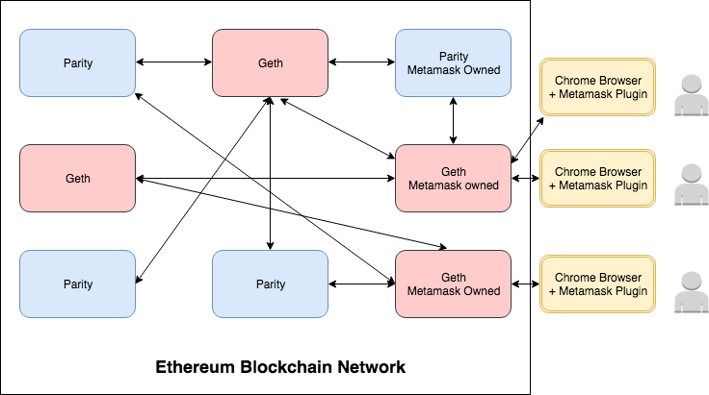
What is MetaMask?
Chrome / Firefox plugin
Install Metamask and it automatically connects to their nodes
Used to interact with the Ethereum node
Host a number of nodes so you don’t have to
https://metamask.io

Slide 22
Using Web3.js in the Browser
In the Web browser we should first check for existing web3 API object
if (typeof web3 !== 'undefined') {
web3 = new Web3(web3.currentProvider);
} else {
// Set the provider you want from Web3.providers
web3 = new Web3(new Web3.providers.HttpProvider(
"http://localhost:8545"));
}

Slide 23

Exercise: Simple Voting System
Using Ethereum, Solidity, Web3, Node.js

Slide 24
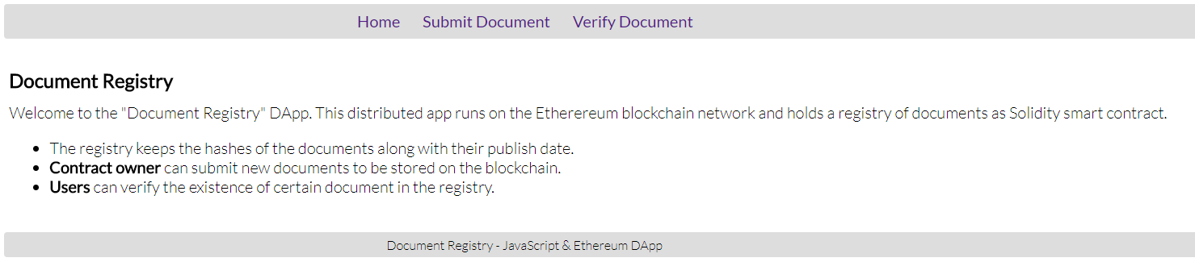
Exercise: Document Registry DApp
Using Ethereum, Solidity, Web3 and MetaMask

Slide 25
Truffle
The most popular development framework for Ethereum
Make your life a whole lot easier
Built-in smart contract compilation, linking, deployment and binary management
Automated contract testing
Scriptable deployment
Migrations Framework
Network management for deploying – public & private

Slide 26
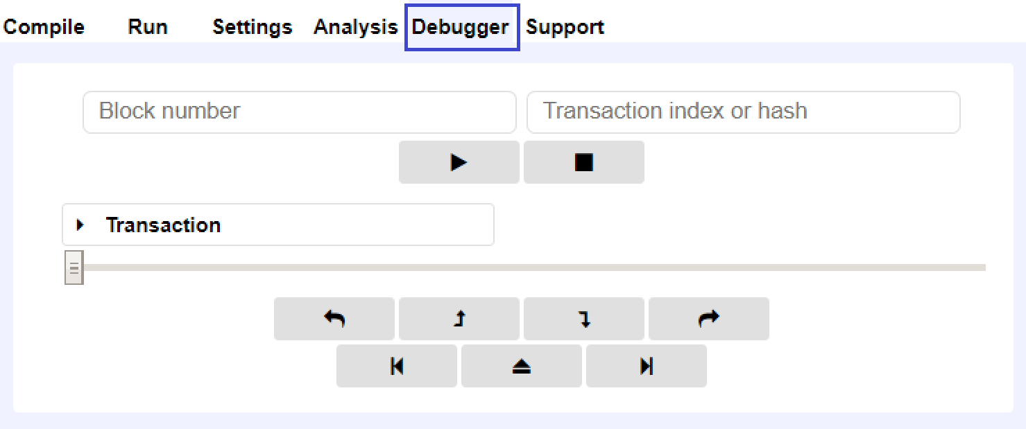
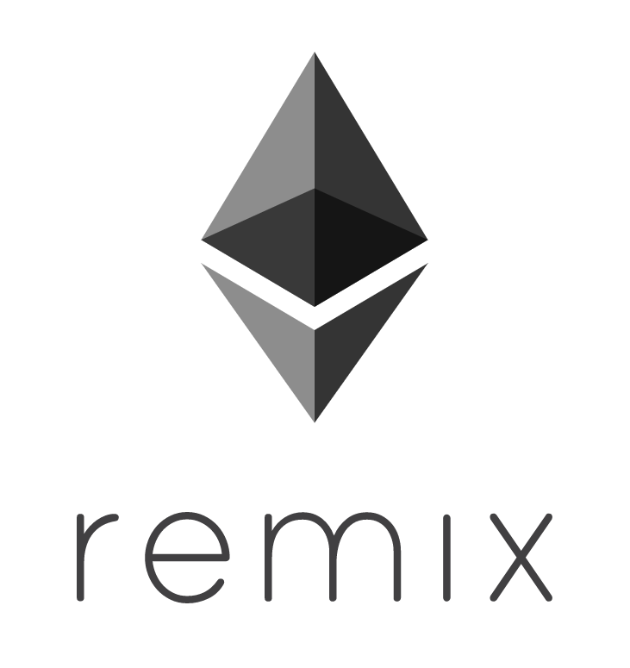
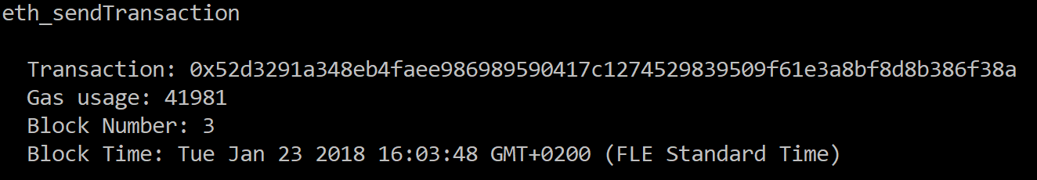
How to Debug?
Remix – Debugger Tab
Run testrpc on one and then truffle debug 0x52d3291a348eb4... on another console

Slide 27



Front-End Frameworks
Angular
React
Vue.js

Slide 28
Truffle Boxes
Helpful boilerplates
Allow you to focus on what makes your DApp unique
Can contain other helpful modules, Solidity contracts & libraries, front-end views and more
react – http://truffleframework.com/boxes/react
react-auth – http://truffleframework.com/boxes/react-auth
react-uport – http://truffleframework.com/boxes/react-uport
tutorialtoken – http://truffleframework.com/boxes/tutorialtoken
webpack – http://truffleframework.com/boxes/webpack

Slide 29
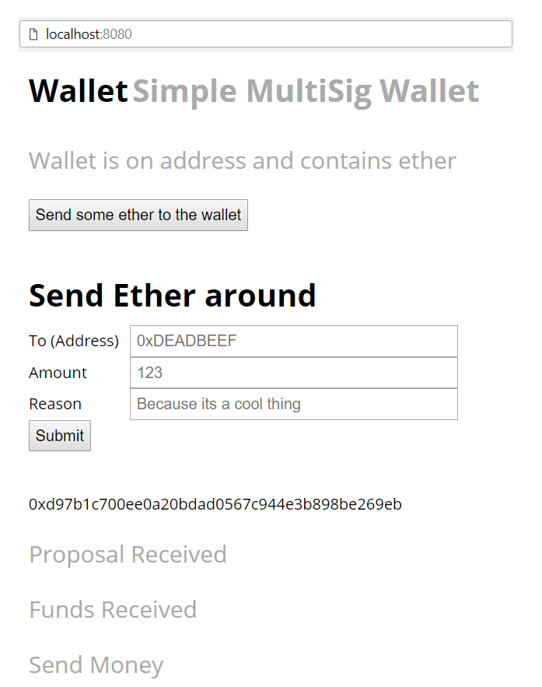
Exercise: Simple Wallet
Using Ethereum, Truffle, Angular, Web3

Slide 30
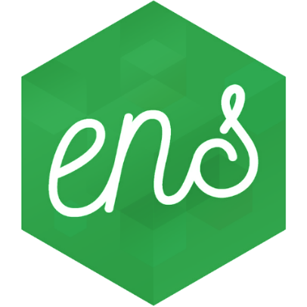
ENS
Ethereum Naming System is the DNS for the Ethereum world
Мap any Ethereum contract or wallet address to a human readable name
Example: 146.115.22.177 → google.com
Example for Ethereum world: 0x80C013d980aB049471c88E1603b8b4a60E03295C → mywallet.eth
https://ens.domains

Slide 31
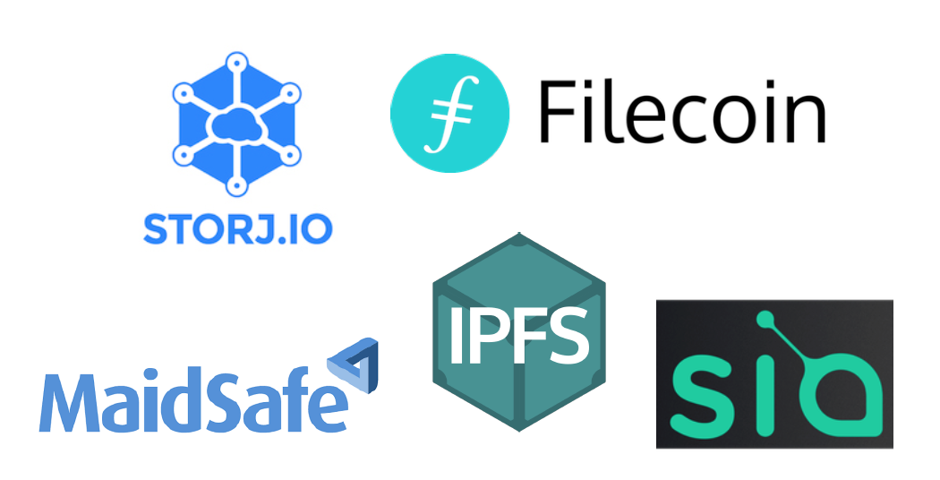
Decentralized Storage
IPFS and Swarm

Slide 32
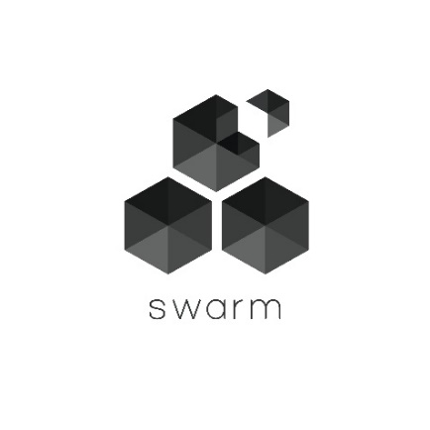
Swarm
Decentralized content storage
Distribution service
Distributed on computers across the internet
Run a swarm node to connect to the Swarm network
When you deploy an Ethereum contract on to the blockchain
Deployed address
JSON interface of the ABI
In the future, the ABI will be stored on Swarm
https://github.com/ethersphere/swarm
http://swarm-guide.readthedocs.io/en/latest/introduction.html

Slide 33

IPFS
IPFS == Inter Planetary File System
Conceptually exactly similar to Swarm
Decentralized storage system
Not related to Ethereum directly
Can be integrated with Ethereum
https://ipfs.io
Differences between Swarm and IPFS here: https://github.com/ethersphere/go-ethereum/wiki/IPFS-&-SWARM

Slide 34
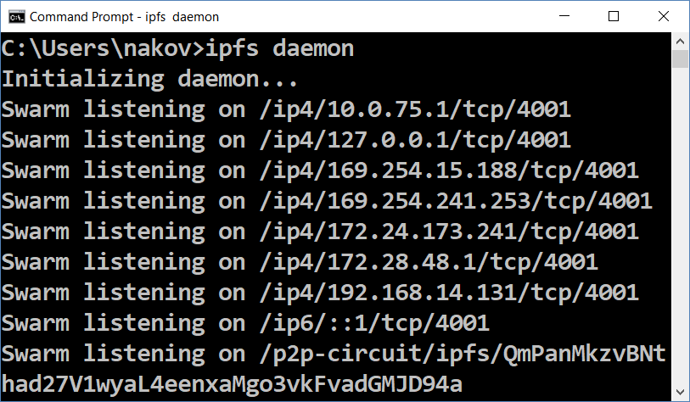
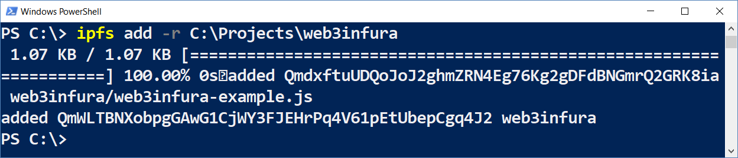
Running IPFS and Uploading Data
Install IPFS – https://dist.ipfs.io/#go-ipfs
Run the IPFS daemon
Adding files to the IPFS
ipfs daemon
ipfs add -r C:\Projects\web3infura

Slide 35
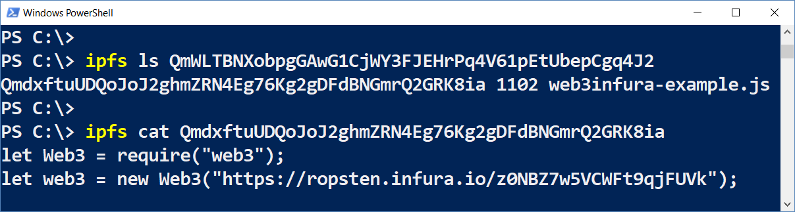
IPFS: Accessing the Resources
ipfs ls QmWLTBNXobpgGAwG1CjWY3FJEHrPq4V61pEtUbepCgq4J2
ipfs cat QmdxftuUDQoJoJ2ghmZRN4Eg76Kg2gDFdBNGmrQ2GRK8ia

Slide 36
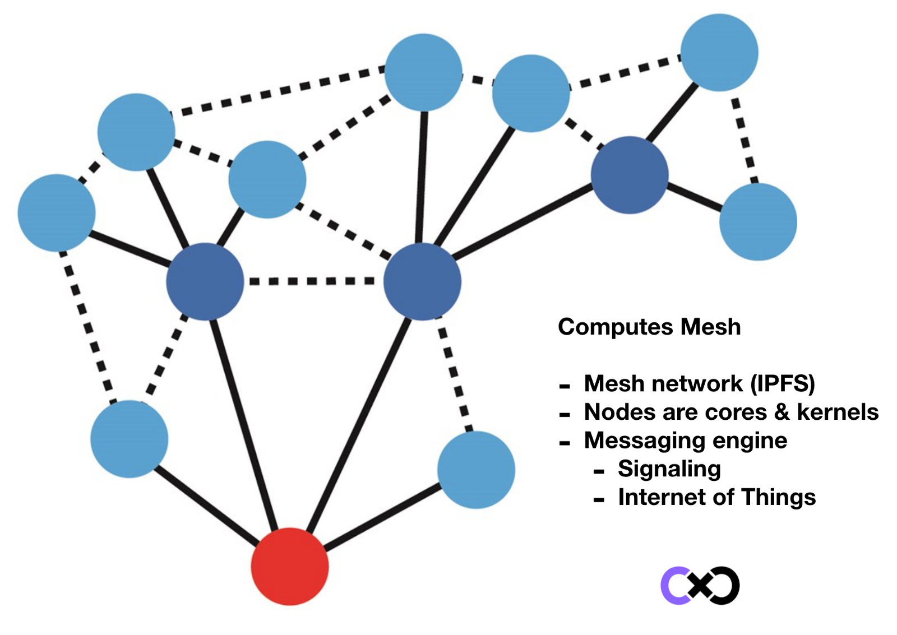
IPFS: How It Works?
Node hold content
Identified by ID
Can "pin" content from other nodes (by ID)
Content is cached for few hours in each node
If a node goes down, its content goes unavailable
Unless it is pinned by someone

Slide 37
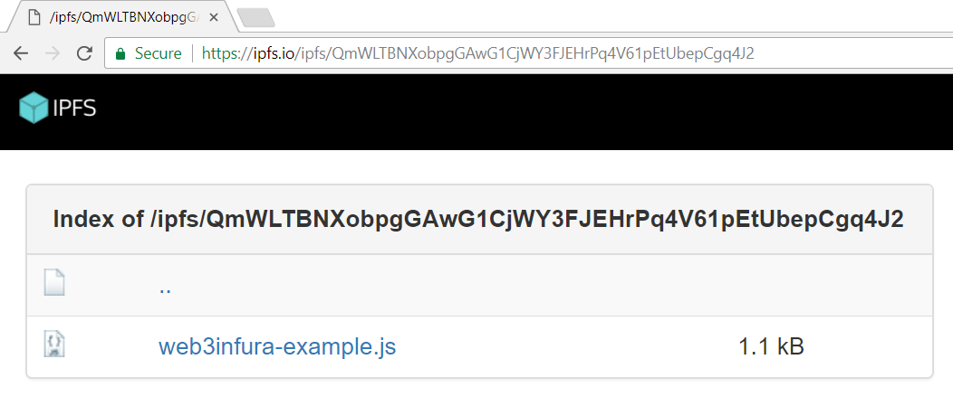
IPFS: HTTP Gateway
IPFS resources can be accessed through https://ipfs.io/ipfs/{id}

Slide 38
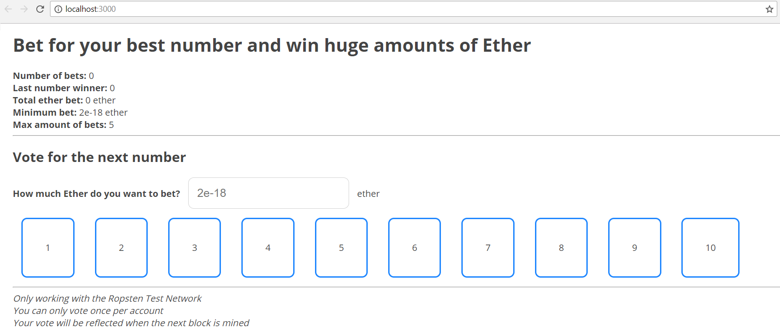
Exercise: Casino
Ethereum, Truffle, React, Web3, IPFS, MetaМask

Slide 39

Summary
Decentralized Applications – hold backend code and data on the blockchain, front-end is a traditional app
Ganache / TestRPC – Node.js Ethereum based client for testing and developing
Geth – Ethereum client written in GO (official client software)
Parity – Ethereum client written in Rust
Infura – Ethereum JSON RPC Service
Metamask – Chrome plugin to interact with Ethereum node
Web3.js – JavaScript library interacting with nodes
Truffle – Development framework for Ethereum

Slide 40
Building DApps with Ethereum
http://www.kingsland.academy

Slide 41
Resources
Ethereum Ecosystem Tools: https://medium.com/blockchannel/tools-and-technologies-in-the-ethereum-ecosystem-e5b7e5060eb9
Infura: https://infura.io/
Truffle Boxes: http://truffleframework.com/boxes/

